Slide 1
Certificate | Customer Service
Editor | Amy R., Emma L.
Subject Matter Expert
Storyboard approval by:

Slide 2
Glossary
Key Term | Definition | Section in which the term is introduced
Notes:
Note to Designer:
Narration:
The following 2 slides outline key terms and their definitions of concepts covered in this micro-lesson.

Slide 3
Glossary
Key Term | Definition | Section in which the term is introduced
ATA | Air Transport Association | Slide 90
SRM | Manufacturer's structural repair manual | Slide 90
Notes:
Note to Designer:
Narration:

Slide 4
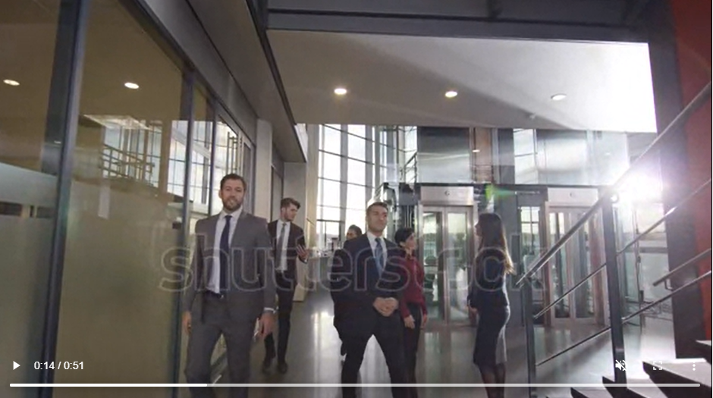
Module 1: Introduction to Customer Service
 | Image Notes:
Image Suggestions: Shutterstock 21773905 (51 seconds. Placeholder for now, waiting to review w/Chuck)
Welcome to the Customer Service Certificate
Module 1
Introduction to Customer Service
Image Suggestions: Shutterstock 21773905 (51 seconds. Placeholder for now, waiting to review w/Chuck)
Notes:
Note to Designer:
Background image: Suggestion: Add graphics to the first part of the visual then transition to the Customer Service certificate on the intro slide
Visual: Use a short clip from the 45 sec video below and then transition to the existing picture that comprises the Customer Service certificate
Narration:

Slide 5
Module 1: Introduction to Customer Service
 | Image Notes:
About the Building Operator Designation Program
Notes:
Note to Designer:
*Video of aerial view of rooftop (from prototype) with voiceover
*Timed with voiceover, the BOD/PMIC/MEC Real Learning logos appear on screen
Narration:
Welcome to the Building Operator Designation BOD Program. The program curriculum responds to the skills and competencies required of a building operator to effectively operate a commercial building. In tandem with commercial real estate industry professionals, the POD program is proudly developed and delivered by the Property Management Institute of Canada and MEC Real Learning. We would like to thank you for selecting the certificate and look forward to seeing you progress through all programs certificates to ultimately achieve your BOD or Building Operator Designation.
Select next to proceed.

Slide 6
Module 1: Introduction to Customer Service
 | Image Notes:
Notes:
Note to Designer:
*The collage of coloured certificates with v/o, similar to prototype (Customer Service is larger than the rest)
*As the voice over is read, the full list of certificates on a single line in one column (with customer service present)
The following text will be said as a voice over when the list of certificates comes up
Here is a current list of certificates that you will complete throughout the program.
Select next to proceed.
Narration:
This certificate is a part of a series of comprehensive online self-paced e-learning certifications that encompass the Building Operator Designation and address a range of professional topics and disciplines for building operators. The development of the curriculum for the certificates was the result of the support and contribution of subject matter experts from across the country who will be recognized at the end of each module.
The following text will be said as a voice over when the list of certificates comes up
Here is a current list of certificates that you will complete throughout the program.
Select next to proceed.

Slide 7
Module 1: Introduction to Customer Service
 | Image Notes:
(Use text and image similar to prototype)
Familiarize yourself with the player controls.
The shows or hides the menu. The transcript button shows the transcript for the slide.
Use the previous and next buttons to navigate through the slides.
The speaker icon controls the audio volume.
The CC icon brings up the closed captioning.
The play button and the seek bar controls the slides progression.
Select next to proceed.
Notes:
Note to Designer:
Text should appear on screen in sync with the voice over narration
Narration:
Familiarize yourself with the player controls.
The shows or hides the menu. The transcript button shows the transcript for the slide.
Use the previous and next buttons to navigate through the slides.
The speaker icon controls the audio volume.
The CC icon brings up the closed captioning.
The play button and the seek bar controls the slides progression.
Select next to proceed.

Slide 8
Module 1: Introduction to Customer Service
 | Image Notes:
Globally: Add the slide with the 8 Module names present, BOD logo and Customer Service Certificate cover with the current module bolded
In this certificate we will cover 8 modules including;
Module 1 - Introduction to Customer Service
Module 2 - Ethos and Integrity
Module 3 - Managing Customer Expectations
Module 4 - Personality Types
Module 5- Customer Relations and Effective Communication Skills
Module 6 - Taking Responsibility and Problem Solving
Module 7 - Customer Service Through Change Management
Module 8 - Real Life Customer Service Scenarios
Notes:
Note to Designer:
*This is the list of 8 modules with v/o and the current module boxed or highlighted
*All modules that have been completed will be grayed out and the keyline box appears on the current module they are taking
Text should appear on screen in sync with the voice over narration
Narration:
In this certificate we will cover 8 modules including;
Module 1 - Introduction to Customer Service
Module 2 - Ethos and Integrity
Module 3 - Managing Customer Expectations
Module 4 - Personality Types
Module 5- Customer Relations and Effective Communication Skills
Module 6 - Taking Responsibility and Problem Solving
Module 7 - Customer Service Through Change Management
Module 8 - Real Life Customer Service Scenarios
select next to proceed.

Slide 9
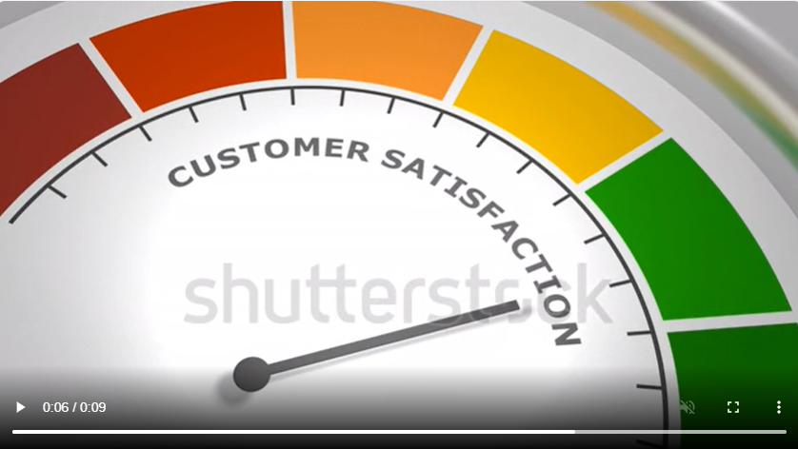
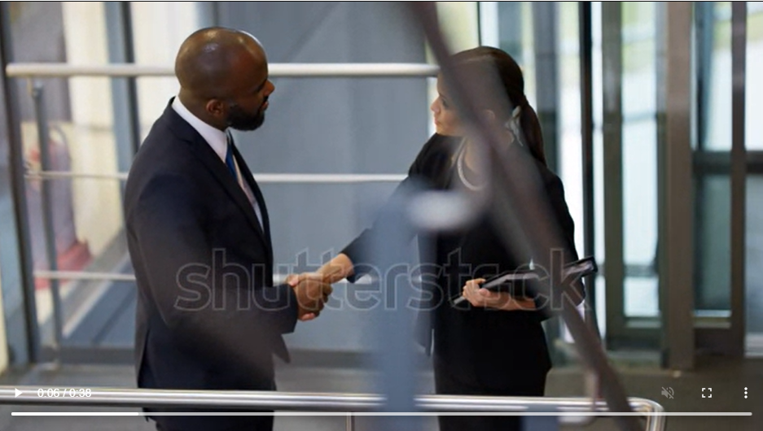
Module 1: Introduction to Customer Service
 | Image Notes:
We need video (45sec) or series of images to slide through while voice is playing
Image Suggestions: Shutterstock 22828258 (38 seconds. Placeholder for now, waiting to review w/Chuck)
Image Suggestions: Shutterstock 1092289149 (9 seconds. Placeholder for now, waiting to review w/Chuck)
This module will help you to understand:
What Customer Service is.
The importance of Customer Service and the impacts of poor Customer Service.
The different strategies provided for improving Customer Service
Notes:
Note to Designer:
Please have the learning objectives pop up beside, or somewhat covering the video- ONLY when they are being read through the voice over. <and> can stay in voice over only.
Text should appear on screen in sync with the voice over narration
Narration:
Welcome to the first of eight modules that make up our Customer Service Certificate- Module 1 What is customer service?
This first module will provide a detailed summary of customer service. It will include the definition of both good and bad customer service, in addition to covering the impacts of each and strategies for improving customer service.
This module will help you to understand:
What Customer Service is.
The importance of Customer Service and the impacts of poor Customer Service.
<and>
The different strategies provided for improving Customer Service.
“Now let’s get started”

Slide 10
Module 1: Introduction to Customer Service
 | Image Notes:
Visual: (Professionals in an office building setting, in discussion in a hallway/boardroom + icons or images related to elements referenced below: email, text, phone, social media.)
Image Suggestions: Shutterstock 1791564398 (Placeholder for now, waiting to review w/Chuck)
3.1.1 What is Customer Service?
Customer service is defined as interactions and exchanges between a customer and a business representative. It is:
Not a single instance or interaction
Essential to ensure your customers have positive experiences with you and your business
In order to be a good partner, you need to be easy to do business with, deliver what your customer wants, and ensure all interactions are timely, efficient, and executed in an enjoyable manner
Notes:
Note to Designer:
Text should appear on screen in sync with the voice over narration
Narration:
Customer service is defined as interactions and exchanges between customer and a business representative.
It is not a single instance or interaction. Instead it’s the interactions throughout the entire journey and relationship; from first contact to becoming a loyal customer.
It’s essential to ensure your customers have positive experiences with you and your business. This relationship begins by being a good partner and understanding your customers’ needs.
To be a good partner you need to be easy to do business with, deliver what your customer wants, and ensure all interactions are timely, efficient, and executed in an enjoyable manner.

Slide 11
Module 1: Introduction to Customer Service
 | Image Notes:
Image Suggestions:
Image Suggestions: Shutterstock 411650377 (Placeholder for now, waiting to review w/Chuck)
Image Suggestions: Shutterstock 1891480069 (Placeholder for now, waiting to review w/Chuck)
Image Suggestions: Shutterstock 1936412359 (Placeholder for now, waiting to review w/Chuck)
3.1.1 How Has Technology Changed Customer Service?
Customer service and the 24 hour day
Technology has moved customer service beyond the hours of 9-5.
Customers may seek support at any time.
Lack of grace and professionalism over email may mean a loss of potential customers.
Customer service is now more complicated.
Many opportunities for improvement exist.
Notes:
Note to Designer:
Text should appear on screen in sync with the voice over narration
Narration:
Offering amazing customer service is essential for retaining customers and growing your business.
Today’s customer service goes far beyond a traditional telephone support agent, that is only available within the hours of 9-5.
Advancements in technology have made customers have access to your business through email, web, text message, and social media.
Technology has allowed for customers to seek support at any time- day or night.
You must practice good customer service through all of these mediums, and even 24 hours a day depending on your business.
If you provide excellent customer service face to face, however, lack the grace and professionalism over email, you may lose out on potential customers. In turn, losing out on profit and harming your reputation.
In turn technology has made providing good customer service more complicated due to the many new ways of reaching your customers. However, it has also given businesses more chances to either maintain or improve their expert level of customer service.

Slide 12
Module 1: Introduction to Customer Service
 | Image Notes:
Image Suggestions:
Shutterstock 1924450169 (Placeholder for now, waiting to review w/Chuck)
Shutterstock 2135620051 (Placeholder for now, waiting to review w/Chuck)
3.1.1 Great vs Poor Customer Service
Great Customer Service:
Drives an amazing customer experience
Can be a revenue generator for your organization
Poor Customer Service:
Can harm sales
Cause loss of customers
Hurt business reputations
Cause businesses to fail
Notes:
Note to Designer:
Clicking interaction VO: Click the images to learn more
Text should appear on screen in sync with the voice over narration
Narration:
Great customer support drives an amazing customer experience, especially when your team moves beyond reacting to problems and towards anticipating customers' problems.
Great customer service can be a revenue generator for your organization by giving customers a complete, cohesive experience that aligns with the organization’s purpose. To position yourself and your organization for success, integrating service into the journey at every interaction point is crucial
On the other hand, poor customer service can harm sales, lose customers, hurt business reputations, and even cause businesses to fail. The impact of poor customer service will be explored in more detail in the following sections

Slide 13
Module 1: Introduction to Customer Service
 | Image Notes:
Knowledge Check for Section 3.1.1
Is the following true or false?
Advances in technology have a negative and positive impact on customer service.
True- Although it can be difficult to keep up with the technologies, the advances have also allowed for more opportunities to grow and improve.
Notes:
Note to Designer:
Text should appear on screen in sync with the voice over narration
Narration:
Let’s take a moment to test your knowledge of what we’ve learned so far.
After you’ve made your selection, hit submit. Remember, you have two chances to complete the Knowledge Check and can review previous content to find the correct answer
Is the following true or false?
Advances in technology have a negative and positive impact on customer service

Slide 14
Module 1: Introduction to Customer Service
 | Image Notes:
Image Suggestions: Shutterstock 443078926 (Placeholder for now, waiting to review w/Chuck)
3.1.2 The Importance of Customer Service
Customer experience is a brand differentiator
Customers put weight on customer service
It is the ability to help them deliver excellent service to their own customers
Notes:
Note to Designer:
Click on the image to learn more
Text should appear on screen in sync with the voice over narration
Narration:
Simply put, customer service is important because customers say it is.
Along with price and product, customer experience is a brand differentiator. This means that customers put weight on customer service, not only from an operational stand-point, but also how you make them feel. In other words, it is the ability to help them deliver excellent service to their own customers.

Slide 15
Module 1: Introduction to Customer Service
 | Image Notes:
Image Suggestions: Shutterstock 1662291403 (Placeholder for now, waiting to review w/Chuck)
3.1.2 The Importance of Customer Service
Companies that deliver a superior customer experience will outperform their competitor
A positive experience can create a loyal customer
A positive experience can create Customer Lifetime Value (CLV)
A positive experience can create recommendations and word of mouth promotion
Bottom line:
Effective customer service assures profitability
Effective customer service is an investment in your customers
Notes:
Note to Designer:
Text should appear on screen in sync with the voice over narration
Narration:
Companies that deliver a superior customer experience will outperform their competitor
For instance, a customer that has a positive experience is more likely to become a loyal customer, creating customer lifetime value (CLV), and are likely to recommend and promote your business by word of mouth.
The bottom line with effective customer service is that it assures its profitability because it is an investment into your customers, which you’ll ultimately see in your organization.

Slide 16
Module 1: Introduction to Customer Service
 | Image Notes:
mage Suggestions: Shutterstock 2123526809 (Placeholder for now, waiting to review w/Chuck)
3.1.2 The Impact of Poor Customer Service
Poor Customer Service:
Poor customer service damages customer retention
Poor customer service damages customer acquisition
Poor customer service damages your organization’s reputation
It is more cost effective to invest in exceptional service, rather than neglecting it.
Customer Service is about:
Finding solutions with your customers,
Removing the problems as much as possible through positive experiences
Notes:
Note to Designer:
Text should appear on screen in sync with the voice over narration
Narration:
Companies that deliver a superior customer experience will outperform their competitor
For instance, a customer that has a positive experience is more likely to become a loyal customer, creating customer lifetime value (CLV), and are likely to recommend and promote your business by word of mouth.
The bottom line with effective customer service is that it assures its profitability because it is an investment into your customers, which you’ll ultimately see in your organization.

Slide 17
Module 1: Introduction to Customer Service
 | Image Notes:
Image Suggestions: Shutterstock 2138338229 (Placeholder for now, waiting to review w/Chuck)
Image Suggestions: Shutterstock 1512297677 (Placeholder for now, waiting to review w/Chuck)
3.1.2 The Impact of Poor Customer Service
Providing a great customer experience has an enormous impact on growing an organization
It is easier to reduce the negative impact of poor customer service by making customers feel they are heard
An extraordinary customer experience is one of the largest factors of word-of-mouth marketing
Customers talk. Happy customers talk positively about your business. Unhappy customers talk negatively about your business
Notes:
Note to Designer:
Text should appear on screen in sync with the voice over narration
Narration:
Providing a great customer experience has an enormous impact on growing an organization, as most customers agree that they are happy to pay more for services and products from an organization that is well-known to deliver good customer service experiences.
It is easier to reduce the negative impact of poor customer service by making customers feel they are heard. An extraordinary customer experience is one of the largest factors of word-of-mouth marketing, serving as one of your organizations’ best pitches. Customers talk. Happy customers talk positively about your business. Unhappy customers talk negatively about your business.

Slide 18
Module 1: Introduction to Customer Service
 | Image Notes:
Image Suggestion: an individual in an argument at a store or business I have created 2 options for you to use-Matt
Shutterstock 1492614863 (Placeholder for now, waiting to review w/Chuck)
Shutterstock 1007599798 (20 seconds. Placeholder for now, waiting to review w/Chuck
3.1.2 The Impact of Poor Customer Service
Impacts of Poor customer service:
Loss of even the most understanding customers.
Tenants may rethink leasing space from you.
Tenants may look for space in other facilities.
Suppliers, mechanics, and other professionals may respond with poor service levels
Strained relationships may negatively impact productivity.
Fewer satisfied customers may translate into a negative financial impact.
Notes:
Note to Designer:
Text should appear on screen in sync with the voice over narration
Narration:
The ramifications of poor customer service can be far-reaching, and can cause you to lose even the most understanding customers.
Specifically in commercial buildings, the result of poor customer service will have a significant impact on tenants, as they think twice about leasing their space from you, renewing their lease, and suggesting your property to others.In fact tenants may even look for space in other facilities.
Suppliers, mechanics, and other professionals in your building may respond to your poor customer service with poor service levels. Therein, straining your relationship and negatively impacting the productivity of your business. This can also lead to health and safety issues, if your suppliers and maintenance personnel provide substandard service.
Last, poor customer service results in fewer satisfied customers, which may translate into a negative effect on your bottom line.

Slide 19
Module 1: Introduction to Customer Service
 | Image Notes:
Knowledge Check for Section 3.1.1
Is the following statement true or false?
You do not have to provide good customer service all of the time- there are times where poor customer service is okay.
False- You should always try to provide the best customer service you can.
Notes:
Note to Designer:
Text should appear on screen in sync with the voice over narration
Narration:
Let’s take a moment to test your knowledge of what we’ve learned so far.
After you’ve made your selection, hit submit. Remember, you have two chances to complete the Knowledge Check and can review previous content to find the correct answer
Is the following statement true or false?
You do not have to provide good customer service all of the time- there are times where poor customer service is okay

Slide 20
Module 1: Introduction to Customer Service
 | Image Notes:
Visual: (Representative happily greeting and working with customer(s) to resolve their issue(s).
Shutterstock 21818953 (44 seconds. Placeholder for now, waiting to review w/Chuck)
Shutterstock 21818881 (29 seconds. Placeholder for now, waiting to review w/Chuck)
3.1.3 What Can You Do To Improve Customer Service?
What can you do to improve customer service?
Understand your customers' wants and needs.
Build trust.
Be consistent.
Check in with customers and ask for feedback.
Be adaptable to your customers’ needs.
Notes:
Note to Designer:
Text should appear on screen in sync with the voice over narration
Narration:
Let’s move to your next topic: What can you do to improve Customer Service?
What are your customers’ challenges? What do they want and what are their expectations in your partnership?
First, if you understand your customers wants and needs, you are able to deliver more effectively.
The next step to improve customer service is building trust. This takes consistency, transparent communication, and building a long-term connection/relationship.
Although it’s impossible to deliver perfect service 100% of the time, and customers understand that, what's important is communicating and being responsive.
Simply acknowledging there’s an issue and communicating your plan to resolve it can go a long way in your partnership.
It is also a good idea to check in with your customers and ask for feedback. This is the best way to gather information and use it to improve areas needed.
Remember, your customers’ needs, just like yours, are always changing, so you must also be adaptable to these changes.
.

Slide 21
Module 1: Introduction to Customer Service
 | Image Notes:
Visual: (Team of five happy young professionals standing in row and holding hands. Business community, teamwork, unity and support concepts.)
Image Suggestions: Shutterstock 1366009967 (Placeholder for now, waiting to review w/Chuck)
Shutterstock 748719859 (Placeholder for now, waiting to review w/Chuck)
Shutterstock 1627604650(Placeholder for now, waiting to review w/Chuck)
Shutterstock 1689338029 (Placeholder for now, waiting to review w/Chuck)
3.1.3 Building Loyalty
Building Loyalty:
Active listening
Know your customers’ communication style and respond accordingly
Be mindful of body language and tone of voice
Create a consistent customer service process
Notes:
Note to Designer:
Text should appear on screen in sync with the voice over narration
Narration:
Building loyalty with your customers goes far beyond just recognizing and addressing a situation.
Active listening will help you as a Building Operator to understand the customers’ underlying needs, their feelings and help you view things from their perspective.
It’s important to know your customers’ communication style and be able to respond accordingly. Whether they prefer face to face meetings, emails, or phone calls, it will all depend on the expectations of your customer.
Your attitude introduces you to your customers before you even speak, so being mindful of your body language and tone of voice is critical.
Creating a consistent process, whether it be with meetings or communication, will not only keep you organized and focused but will help the customer know what to expect, and helps build trust.
.

Slide 22
Module 1: Introduction to Customer Service
 | Image Notes:
Visual: (Team of young professionals working on process documents or addressing issues.)
Image Suggestions: Shutterstock 1046595526 (29 Seconds. Placeholder for now, waiting to review w/Chuck)
3.1.3 Elements of Service
Tenant Contract
This is where you will find expectations and policies surrounding pricing and services
Going above and beyond:
Ask questions and dig deeper
Think about the future and have a plan for moving forward.
Be proactive in your approach.
Notes:
Note to Designer:
Text should appear on screen in sync with the voice over narration
Narration:
The most expected customer service elements will be in the tenant contract; this is where you will find expectations and policies surrounding pricing and services.
There are, however, intangible elements of service that could add value to the customer.
It will be up to you to ask questions and dig a little deeper to provide above and beyond service.
Thinking about the future and having a plan for moving forward will keep you prepared for things that will be out of your control.
Be proactive in your approach, be aware of potential issues before they even arise, and communicate them to your customer. The customer will be less likely to complain once they have been informed.
.

Slide 23
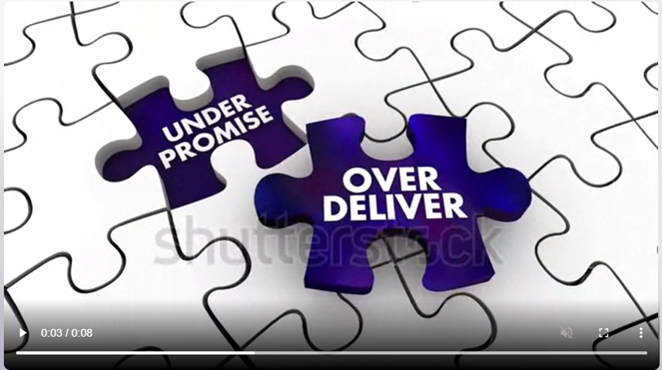
Module 1: Introduction to Customer Service
 | Image Notes:
Visual: (Support customer service business technology concept on virtual screen.)
Image Suggestions: Shutterstock 1040430605 (8 Seconds. Placeholder for now, waiting to review w/Chuck)
Image Suggestions: Shutterstock 1091049155 (8 Seconds. Placeholder for now, waiting to review w/Chuck)
3.1.3 Elements of Service
Have quality systems or processes in place to help manage schedules.
“Under promise & Over Deliver”
Transparent communication - focus on what you can do as opposed to what you can’t do.
Making the assumption that a customer is happy because they haven’t made a complaint is dangerous.
Notes:
Note to Designer:
Text should appear on screen in sync with the voice over narration
Narration:
Having quality systems or processes in place to help manage schedules, as well as provide checks and balances to help improve is paramount.
Customers look at deadline dates as though they are written in stone. It never hurts to give a buffer, add a couple of days to allow for delays – “Under promise & Over Deliver”.
There are limitations in customer service such as the lease agreement, contracts etc., but through transparent communication, you can focus on what you can do as opposed to what you can’t do.
Last, making the assumption that a customer is happy because they haven’t made a complaint is dangerous..

Slide 24
Module 1: Introduction to Customer Service
 | Image Notes:
Image suggestion: 64% that the individual can click to learn about the statistic.
Image suggestion: 34% that the individual can click to learn about the statistic.
Image suggestion: 40% that the individual can click to learn about the statistic.
Image suggestion: 12:1 ratio that the individual can click to learn about the statistic.
3.1.3 Quick Facts About Customer Service
Good customer service goes a long way, just as poor customer service can significantly hurt your business.
Customers are 64% more likely to try a company’s new offering if they think the company has very good customer service. (Qualtrics XM Institute, ROI of Customer.)
Customers who rate a company as delivering “good” customer experience are 34% more likely to purchase more, and 37% more likely to recommend. (Qualtrics XM Institute, ROI of Customer Experience)
Only 40% will trust a company if it has poor customer experience (vs. 76% - good). (Qualtrics XM Institute)
Note: It takes 12 positive experiences to make up for 1 unresolved negative experience. (Ruby Newell-Legner’s “Understanding Customers”)
Notes:
Note to Designer:
Good customer service goes a long way, just as poor customer service can significantly hurt your business. To bring this module to a close let’s review some staggering statistics about customer service to really drive home its importance.
When 64% is clicked:
Customers are 64% more likely to try a company’s new offering if they think the company has very good customer service
When 37% is clicked:
Customers who rate a company as delivering “good” customer experience are 34% more likely to purchase more, and 37% more likely to recommend
When 40% is clicked:
Only 40% will trust a company if it has poor customer experience (vs. 76% - good).
Text should appear on screen in sync with the voice over narration
Narration:
Good customer service goes a long way, just as poor customer service can significantly hurt your business. To bring this module to a close let’s review some staggering statistics about customer service to really drive home its importance.
Customers are 64% more likely to try a company’s new offering if they think the company has very good customer service
Customers who rate a company as delivering “good” customer experience are 34% more likely to purchase more, and 37% more likely to recommend
Only 40% will trust a company if it has poor customer experience (vs. 76% - good). It takes 12 positive experiences to make up for 1 unresolved negative experience
“Before continuing to the conclusion of this module, please complete the following knowledge checks and test questions.”

Slide 25
Module 1: Introduction to Customer Service
 | Image Notes:
Module 1 Quiz
Customer service is; (Select the most right answer)
When you hire a customer to become a server of your product
The consistent and ongoing interactions and exchanges between customer and a business representative.
The single moment of customer and employee interaction
A place you go to complain about things
What is NOT one way that technology has changed customer service procedures?
Has allowed for 24 hour access
Has removed the need to customer service
Has made providing good customer service easier and harder
Has removed the need to face to face customer service
Is the following statement true or false? Building customer loyalty is the ONLY reason to provide good customer service.
False- It will also help you get good word of mouth, higher sales, high CLV, and a good reputation to bring in new customers
4. What are some phrases to keep in mind when providing good customer service? Select all that apply.
Under promise- over deliver
Over promise- under deliver
The customer is always wrong
Keep clear and transparent communication with client
Notes:
Note to Designer:
Narration:

Slide 26
Module 1: Introduction to Customer Service
 | Image Notes:
Image suggestion: 64% that the individual can click to learn about the statistic.
Image suggestion: 34% that the individual can click to learn about the statistic.
Image suggestion: 40% that the individual can click to learn about the statistic.
Image suggestion: 12:1 ratio that the individual can click to learn about the statistic.
Summary and Acknowledgement
You now understand what customer service is and why it is so important in different business scenarios.
We would like to thank the following subject matter experts for their contribution and support of this module and important industry initiative.
Lead Module Subject Matter Expert
Supporting Module Subject Matter Experts
Click next to proceed
Notes:
Note to Designer:
As the second line of text above is read, let the following logos appear to match the v/o (MEC to provide)
Text should appear on screen in sync with the voice over narration
End up on the Completion page (to discuss this page and accessing the final module quiz via D2L)
Narration:
You now understand what customer service is and why it is so important in different business scenarios.
We would like to thank the following subject matter experts for their contribution and support of this module and important industry initiative.
Lead Module Subject Matter Expert
Supporting Module Subject Matter Experts
Click next to proceed

